Slide 1
HNDIT2301: Operating System and Information Security
2 Basic cryptography - Part 3

Slide 2
Asymmetric Encryption
Week - 3

Slide 3
Why Asymmetric Encryption?
The concept of public-key cryptography evolved from an attempt to attack two of the most difficult problems associated with symmetric encryption.
Those key issues are:
  key distribution – how to have secure communications in general without having to trust a KDC with your key
  digital signatures – how to verify a message comes intact from the claimed sender

Slide 4
Asymmetric (Public Key) Encryption
uses two keys – a public & a private key
asymmetric since parties are not equal
Asymmetric algorithms rely on one key for encryption and a different but related key for decryption.

Slide 5
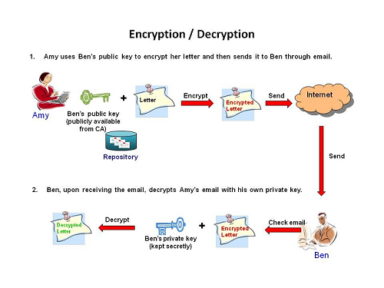

Slide 6
The essential steps are the following:
1. Each user generates a pair of keys to be used for the encryption and decryption of messages.
2. Each user places one of the two keys in a public register or other accessible file. This is the public key. The companion key is kept private.
3. If Bob wishes to send a confidential message to Alice, Bob encrypts the message using Alice's public key.
4. When Alice receives the message, she decrypts it using her private key. No other recipient can decrypt the message because only Alice knows Alice's private key.

Slide 7
Public-Key Cryptography
public-key/two-key/asymmetric cryptography involves the use of two keys:
  a public-key, which may be known by anybody, and can be used to encrypt messages, and verify signatures
  a private-key, known only to the recipient, used to decrypt messages, and sign (create) signatures
is asymmetric because
  those who encrypt messages or verify signatures cannot decrypt messages or create signatures

Slide 8
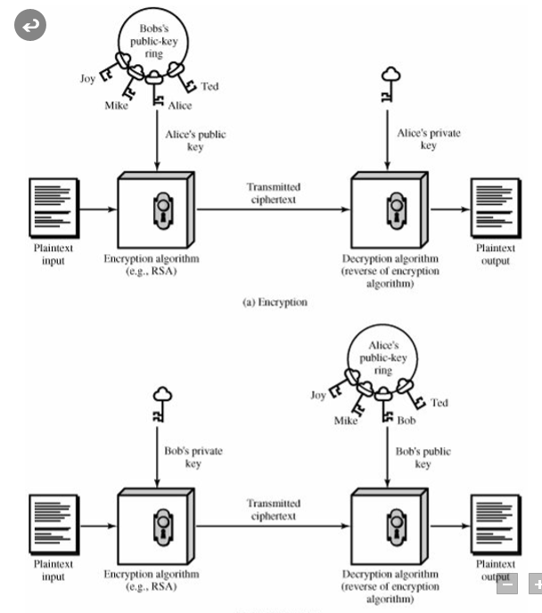

Slide 9
Public-Key Characteristics
Public-Key algorithms rely on two keys where:
  it is computationally infeasible to find decryption key knowing only algorithm & encryption key
  it is computationally easy to en/decrypt messages when the relevant (en/decrypt) key is known
  either of the two related keys can be used for encryption, with the other used for decryption (for some algorithms)

Slide 10
Public-Key Applications
can classify uses into 3 categories:
  encryption/decryption (provide secrecy) The sender encrypts a message with the recipient's public key.
  digital signatures (provide authentication) The sender "signs" a message with its private key
  key exchange (of session keys) Two sides cooperate to exchange a session key. Several different approaches are possible, involving the private key(s) of one or both parties.

Slide 11
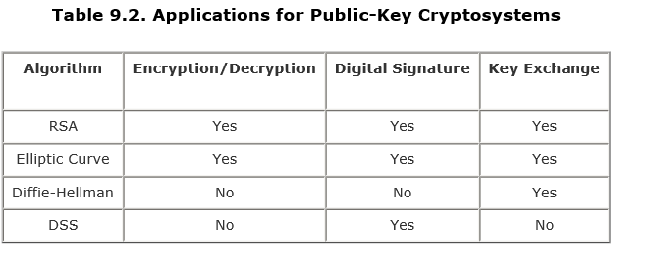
Some algorithms are suitable for all uses, others are specific to one

Slide 12
Security of Public Key Schemes
As with symmetric encryption, a public-key encryption scheme is vulnerable to a brute-force attack.
requires the use of very large numbers:
Use large keys. Public-key systems depend on the use of some sort of invertible mathematical function. The complexity of calculating these functions may not scale linearly with the number of bits in the key but grow more rapidly than that. Thus, the key size must be large enough to make brute-force attack impractical but small enough for practical encryption and decryption.
hence is slow compared to private key schemes:
In practice, the key sizes that have been proposed do make brute-force attack impractical but result in encryption/decryption speeds that are too slow for general-purpose use. Instead, as was mentioned earlier, public-key encryption is currently confined to key management and signature applications.

Slide 13
Key Management
public-key encryption helps address key distribution problems
have two aspects of this:
  distribution of public keys
  use of public-key encryption to distribute secret keys

Slide 14
Distribution of Public Keys
Several techniques have been proposed for the distribution of public keys. Virtually all these proposals can be grouped into the following general schemes:
can be considered as using one of:
  public announcement
  publicly available directory
  public-key authority
  public-key certificates

Slide 15
Public Announcement
users distribute public keys to recipients or broadcast to community at large
  eg. append PGP keys to email messages or post to news groups or email list
major weakness is forgery
  anyone can create a key claiming to be someone else and broadcast it
  until forgery is discovered can masquerade as claimed user

Slide 16
Publicly Available Directory
can obtain greater security by registering keys with a public directory
directory must be trusted with properties:
  contains {name,public-key} entries
  participants register securely with directory
  participants can replace key at any time
  directory is periodically published
  directory can be accessed electronically
still vulnerable to tampering or forgery

Slide 17
Public-Key Authority
improve security by tightening control over distribution of keys from directory
has properties of directory
and requires users to know public key for the directory
then users interact with directory to obtain any desired public key securely
  does require real-time access to directory when keys are needed

Slide 18
Public-Key Certificates
certificates allow key exchange without real-time access to public-key authority
a certificate binds identity to public key
  usually with other info such as period of validity, rights of use etc
with all contents signed by a trusted Public-Key or Certificate Authority (CA)
can be verified by anyone who knows the public-key authorities public-key

